Slide 1
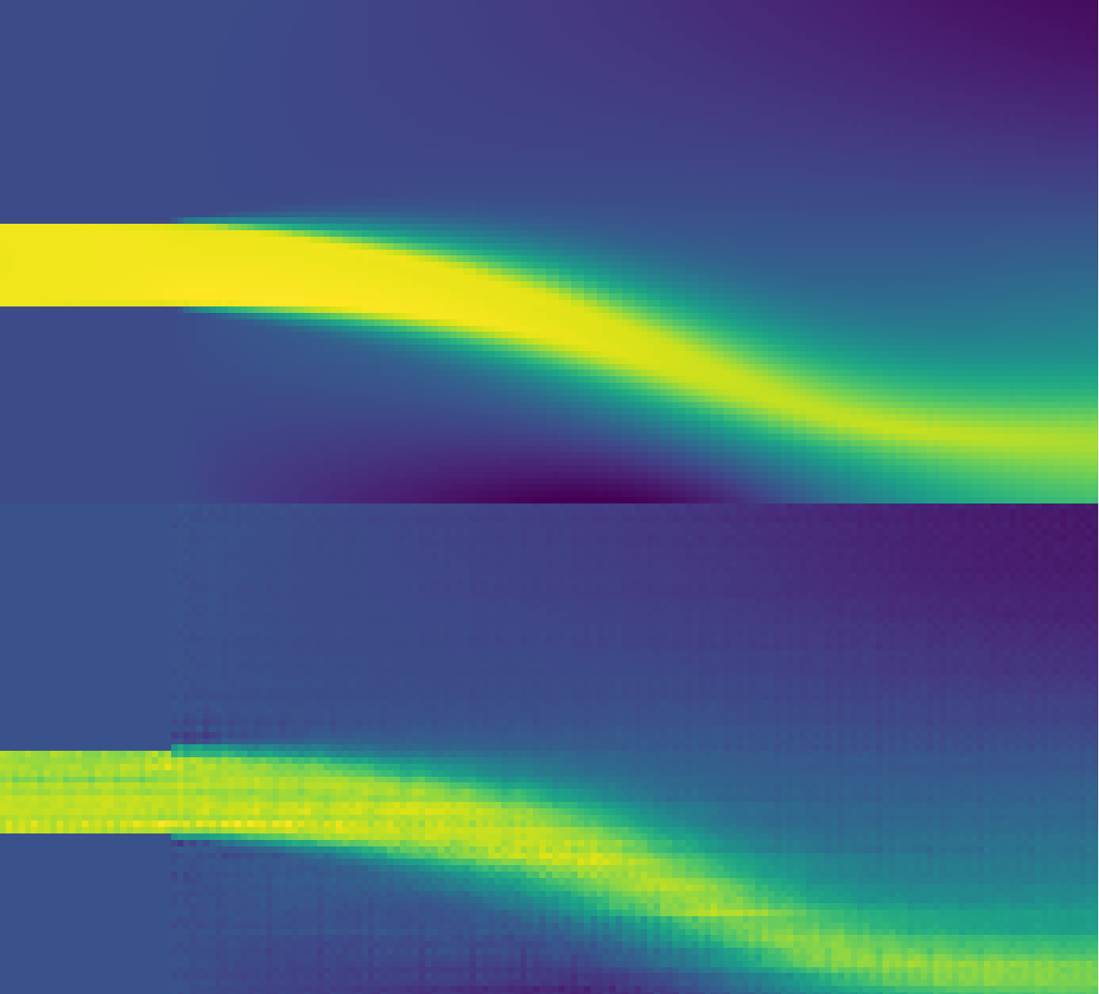

Reduced Order Models for Fluid Flow With Generative Adversarial Networks (GANs)
Interim & Literature Presentation
Mirko Kemna
March 2022

Slide 2
Outline
Motivation & Introduction
Problem Setting & Related Work
Generative Adversarial Networks (GANs)
Methodology
Initial Results
Outlook & Scope

Slide 3
1. Motivation & Introduction

Slide 4
Motivation: Why Machine Learning?
“We already have a great deal of tools and knowledge for modeling fluids, why start over?”
Finding efficient and accurate reduced order models remains a challenge
ML could automate process of model reduction / discovery for specific applications
Scientific machine learning (SciML) has shown success in other fields
Notes:
as has been achieved with other tasks previously restricted to human action

Slide 5
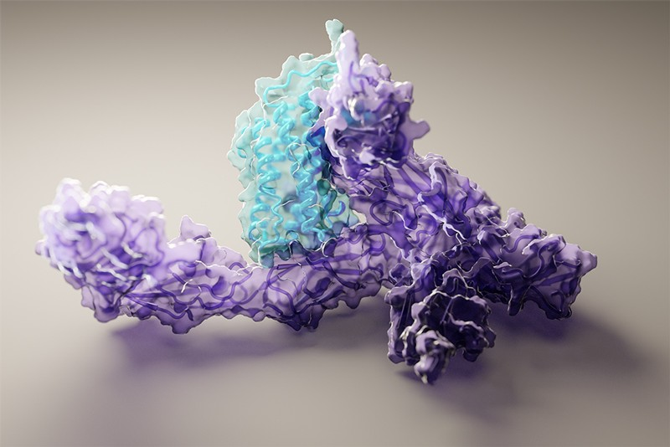
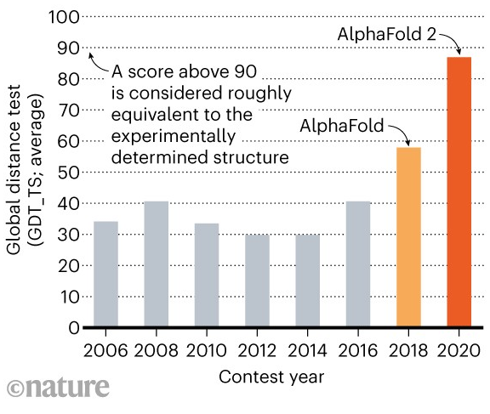
Success Story: Protein Folding
For decades, scientists had been hard at work trying to create reduced order models to predict 3D protein structure from its amino acid sequence
Progress was slow and the problem remained essentially unsolved for large proteins
DeepMind’s AlphaFold 2 AI achieved transformational results
Taken from Callaway, Nature (2021) [?]
Taken from Callaway, Nature (2020) [?]

Slide 6
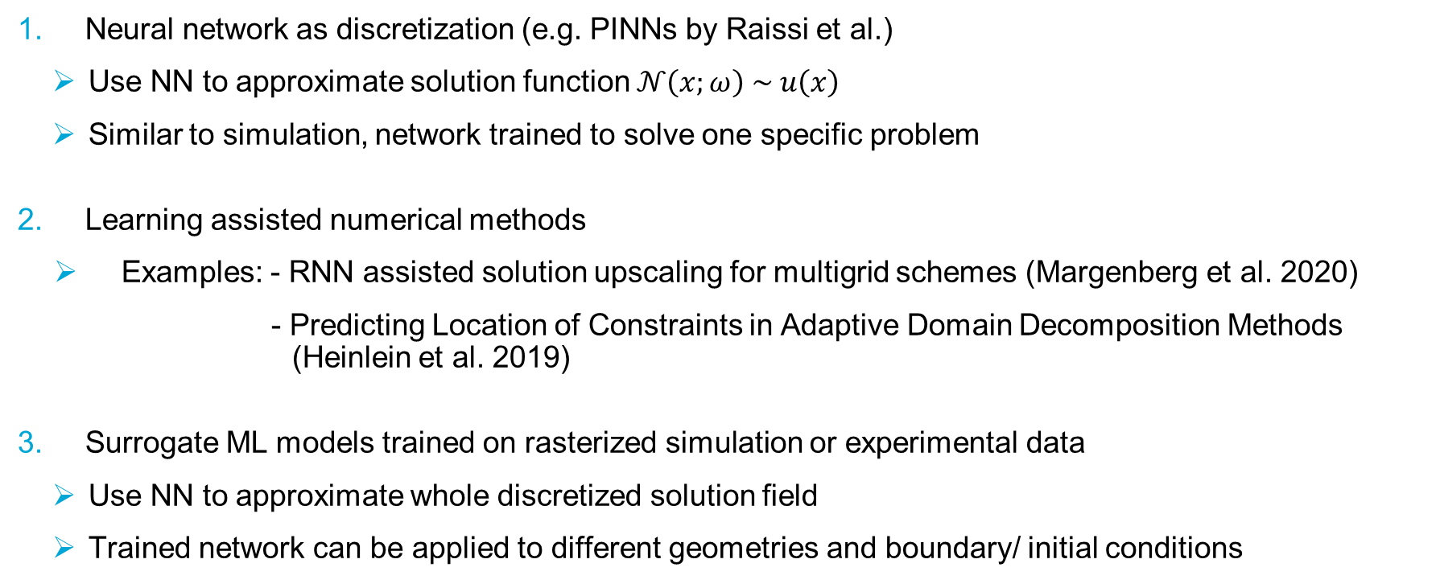
ML Applications for PDE Problems
Neural network as discretization (e.g. PINNs by Raissi et al.)
Use NN to approximate solution function $𝒩\left(x;ω\right) \sim u\left(x\right)$
Similar to simulation, network trained to solve one specific problem
Learning assisted numerical methods
Examples: - RNN assisted solution upscaling for multigrid schemes (Margenberg et al. 2020)
- Predicting Location of Constraints in Adaptive Domain Decomposition Methods (Heinlein et al. 2019)
Surrogate ML models trained on rasterized simulation or experimental data
Use NN to approximate whole discretized solution field
Trained network can be applied to different geometries and boundary/ initial conditions

Slide 7
2. Problem Setting & Related Work

Slide 8
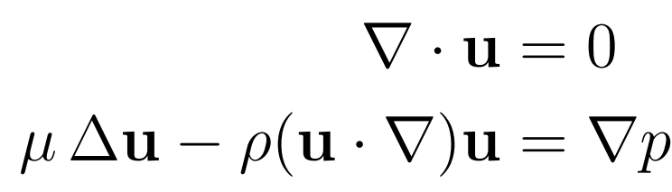
Problem Setting
Goal: Predict flow field from geometry using a generative adversarial network (GAN)
Underlying law is a second order, nonlinear PDE system (Navier-Stokes equations):
Boundary value problem
Train network on simulation data
Simulation includes RANS turbulence model

Slide 9
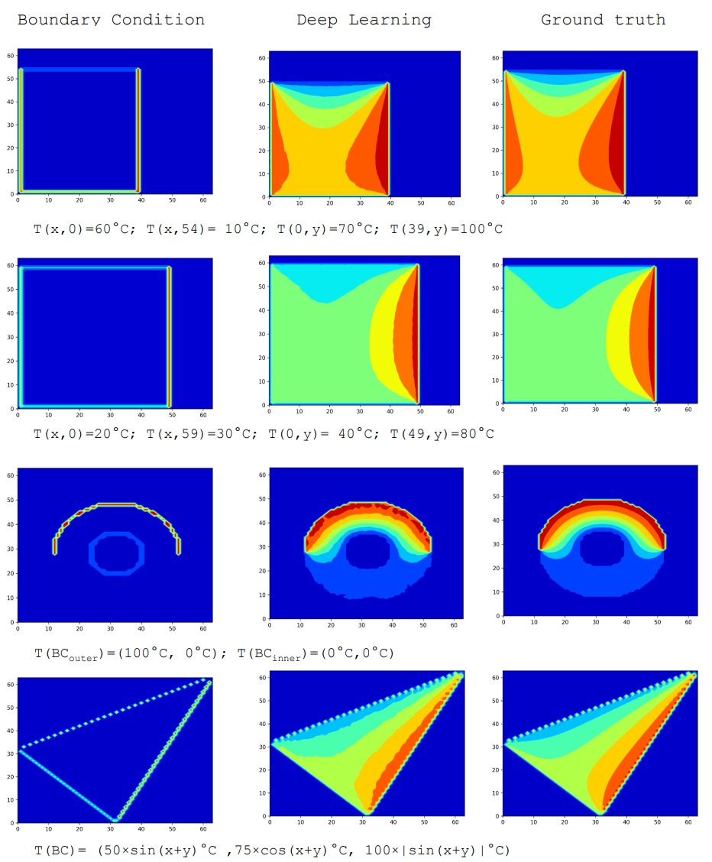
Previous Related Work
Pioneers: Farimani, Gomes & Pande in 2017 [?]
Trained GAN to solve 2D boundary value problems (heat equation and Navier-Stokes)
Domain and boundary values as conditional input
Good results on test set & greatly improved performance over state-of-the-art finite difference solvers

Slide 10
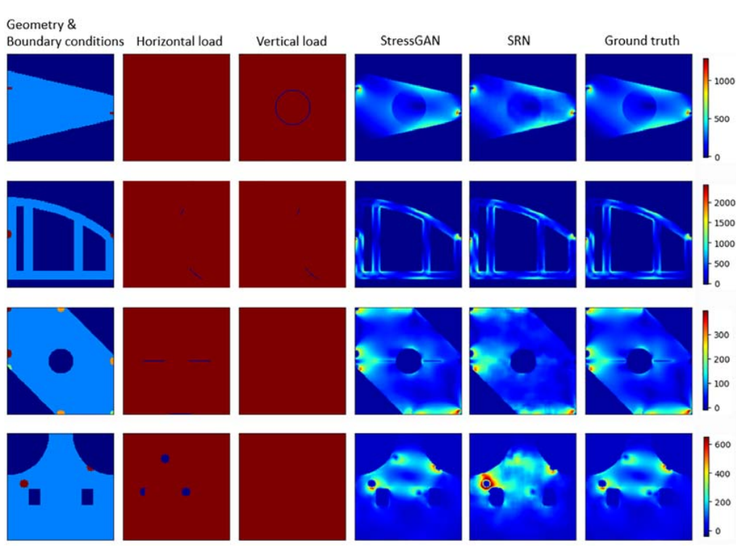
Previous Related Work
Jiang, Nie, Yeo et al. 2021 (StressGAN)
GAN for predicting stress in solids on 2D domain
Complex geometry
Boundary conditions & loads supplied as conditionals
Found GAN to outperform previous regular convolutional model

Slide 11
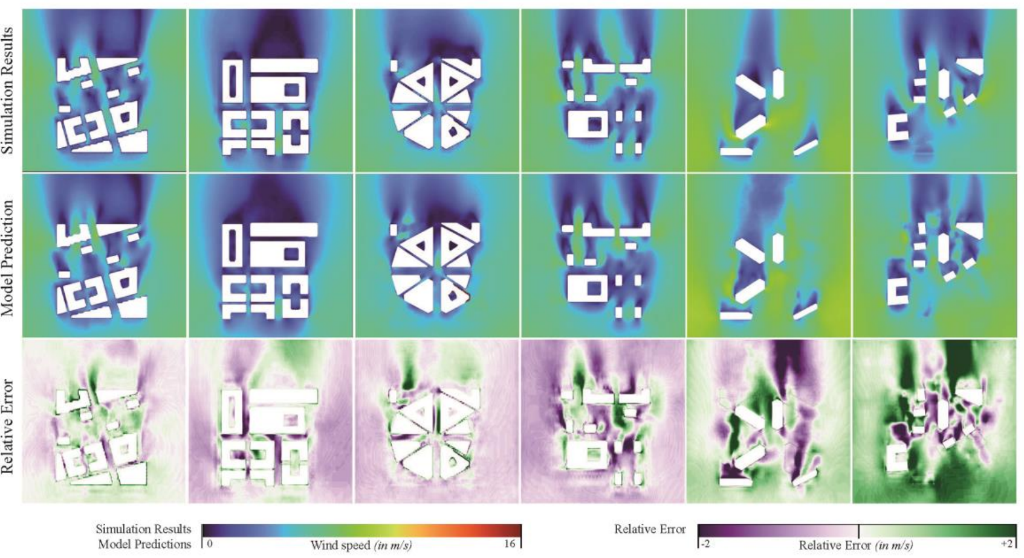
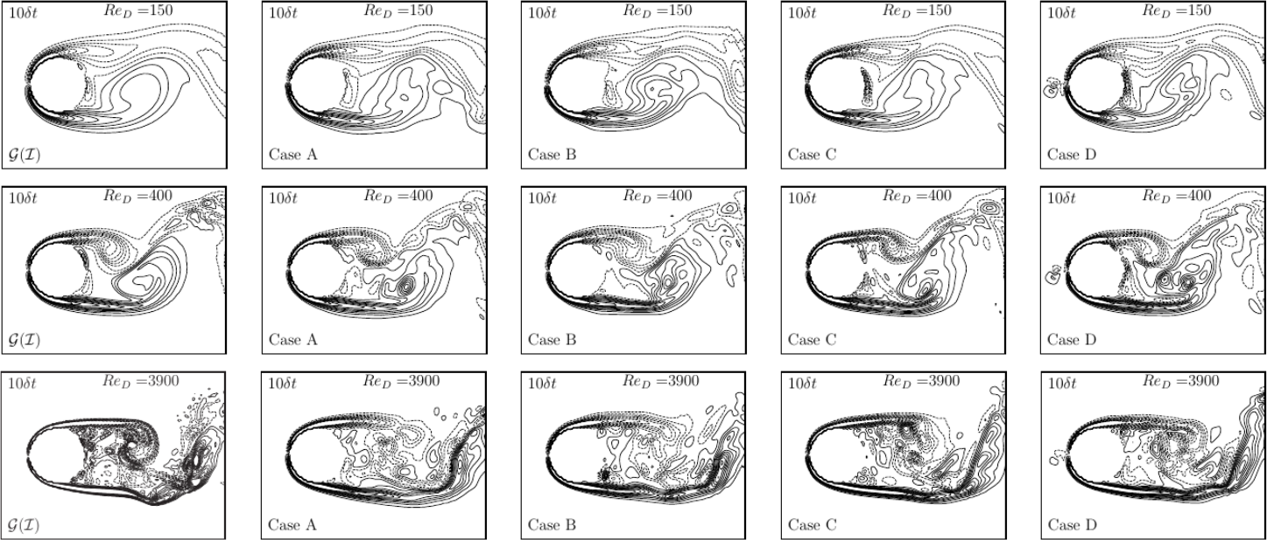
Previous Related Work
Others applied GANs for predicting into the future for transient flow (Lee & You 2019 [?])
Compared GAN to CNN, with and without physics loss
GAN without physics loss best performer for recursive prediction
There have even been application studies, e.g. an architecture firm studied the use of GANs for predicting wind speed in urban setting
Ground
truth
physical
GAN
GAN
physical
CNN
CNN

Slide 12
3. Generative Adversarial Networks (GANs)

Slide 13
What are GANs?
Technique for training generative neural networks
Motivation:
regular ML methods not suitable for generative tasks (e.g. generate realistic images of human faces)
reason: suitable cost function lacking
with GANs, the cost function for the generator is determined as part of the training process
“Forger and critic compete in adversarial zero-sum game”

Slide 14
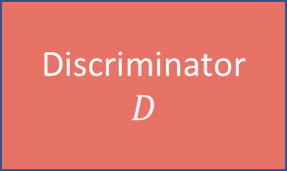
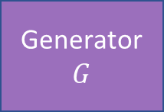
GAN Structure
Training conditionals
Training samples
Latent
space
Discriminator
$$D$$
Generator
$$G$$
“real or forged?”
Conditional
Training feedback

Slide 15
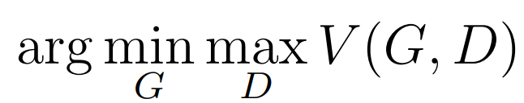
GAN theory & practice
Optimization problem:
Gradient-based iterative optimization of generator and discriminator
Given enough model capacity & training, generator will perfectly match distribution of training data (proof in original GAN paper Goodfellow et al. 2014 [?])
This corresponds to a global optimum & Nash equilibrium
Problem: notoriously hard to train
Improvements have been proposed, e.g. Wasserstein GAN

Slide 16
4. Methodology

Slide 17
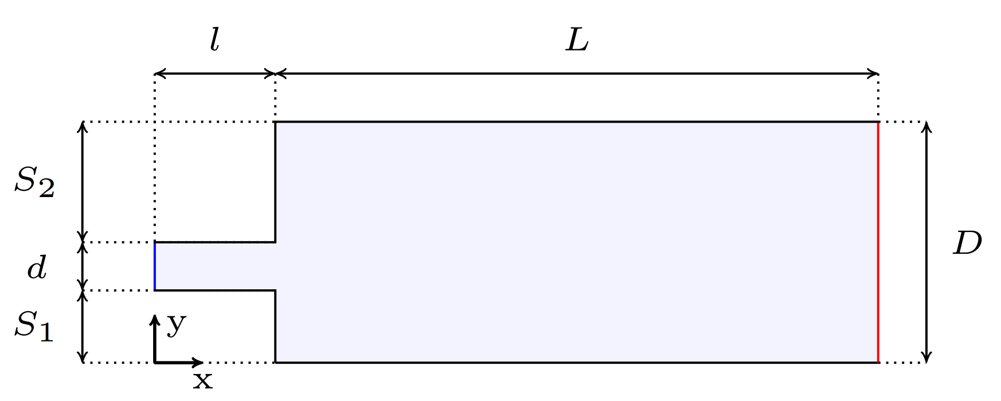
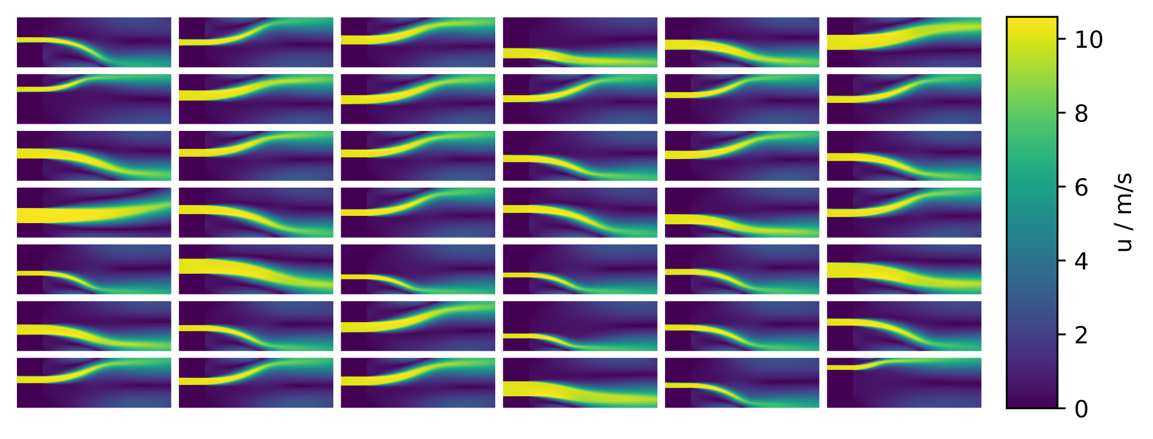
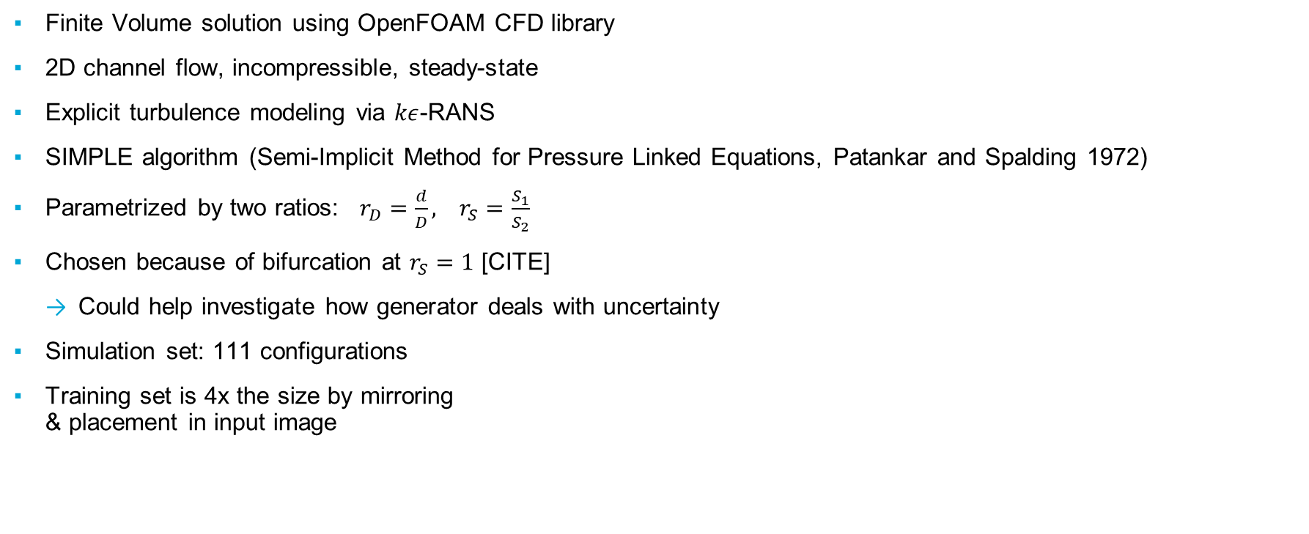
Flow Field Generation using OpenFOAM
Finite Volume solution using OpenFOAM CFD library
2D channel flow, incompressible, steady-state
Explicit turbulence modeling via $kε$-RANS
SIMPLE algorithm (Semi-Implicit Method for Pressure Linked Equations, Patankar and Spalding 1972)
Parametrized by two ratios: $r_{D}=\frac{d}{D}, r_{S}=\frac{S_{1}}{S_{2}}$
Chosen because of bifurcation at $r_{S}=1$ [CITE]
Could help investigate how generator deals with uncertainty
Simulation set: 111 configurations
Training set is 4x the size by mirroring & placement in input image

Slide 18
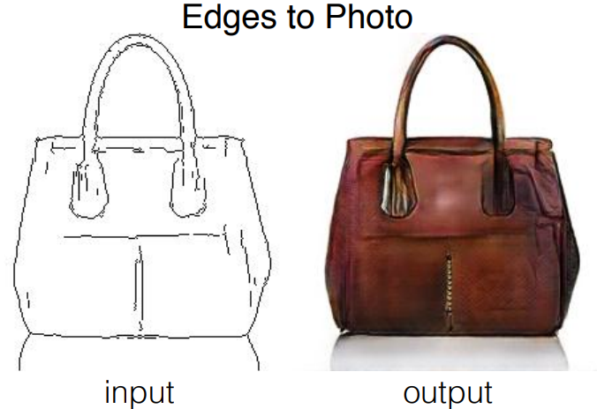
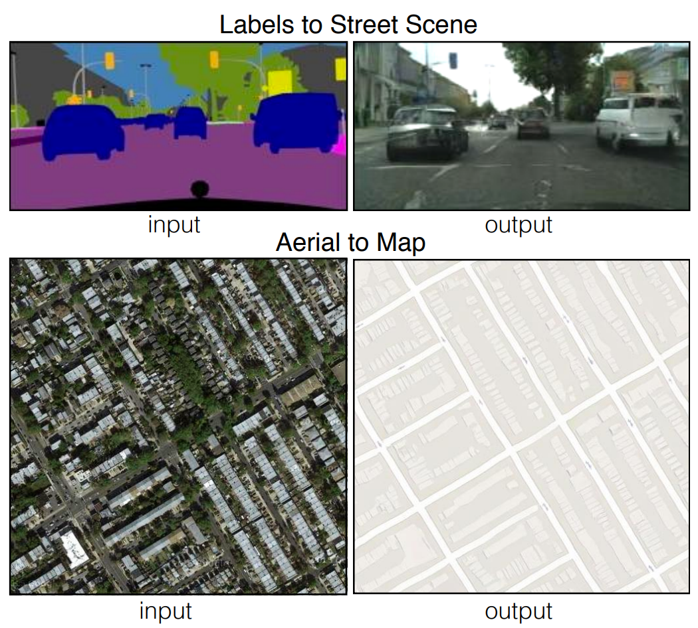
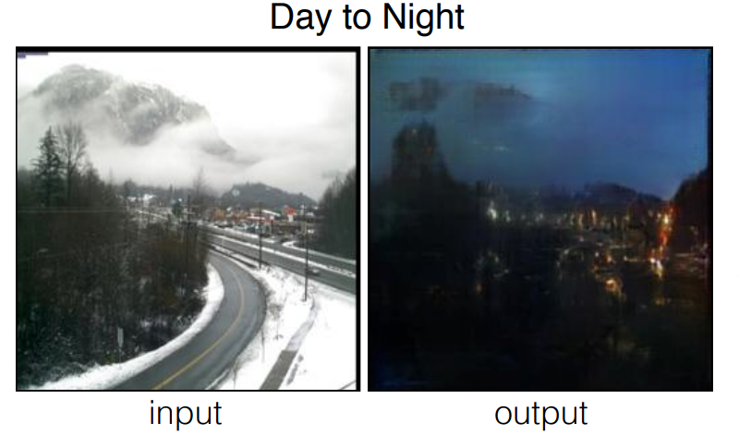
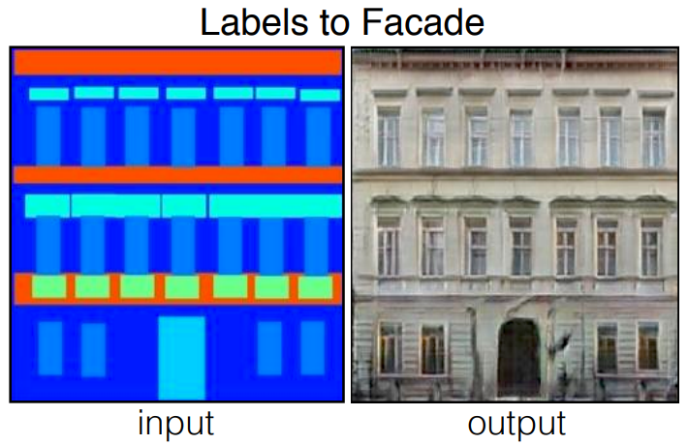
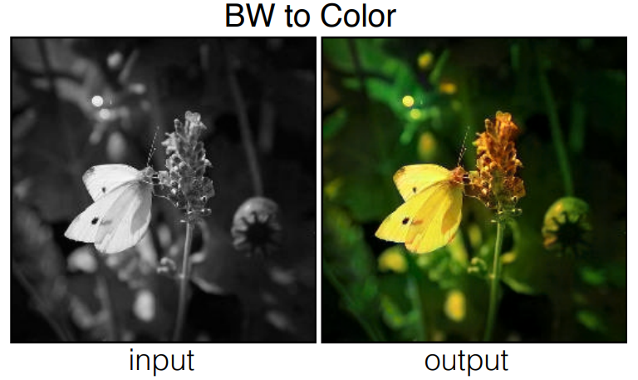
pix2pix
General image-to-image translation GAN framework
Generator with U-Net Architecture
PatchGAN Discriminator
Standard version uses adversarial & L1 ground truth loss for generator

Slide 19
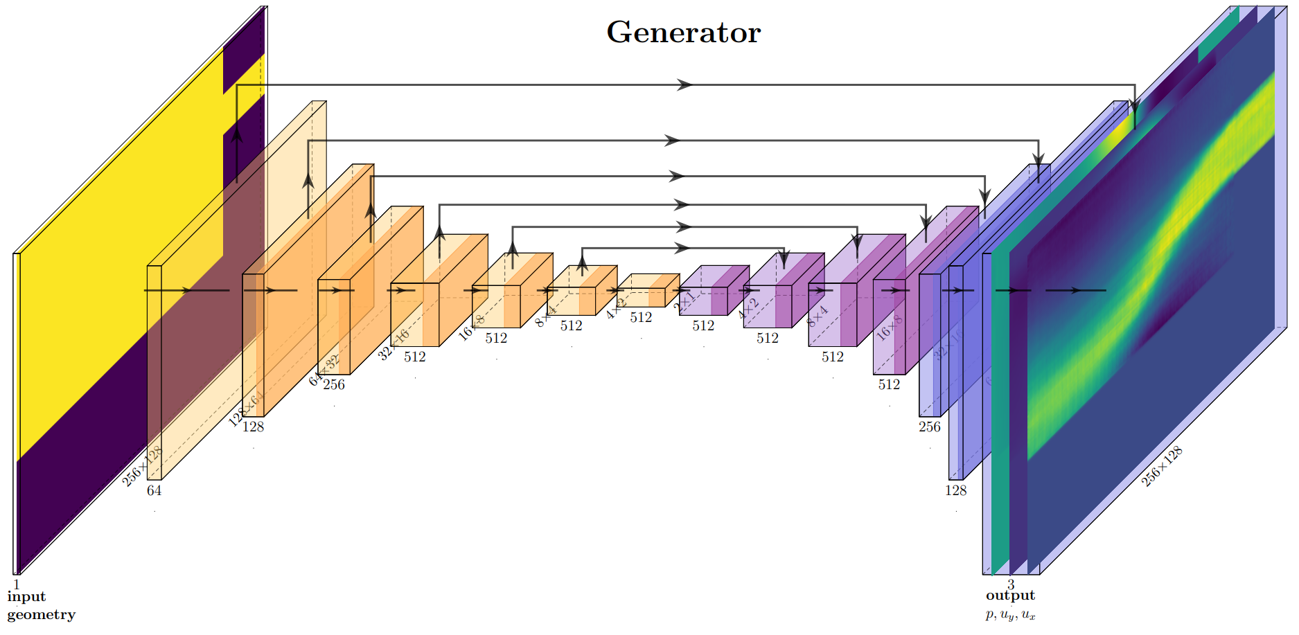
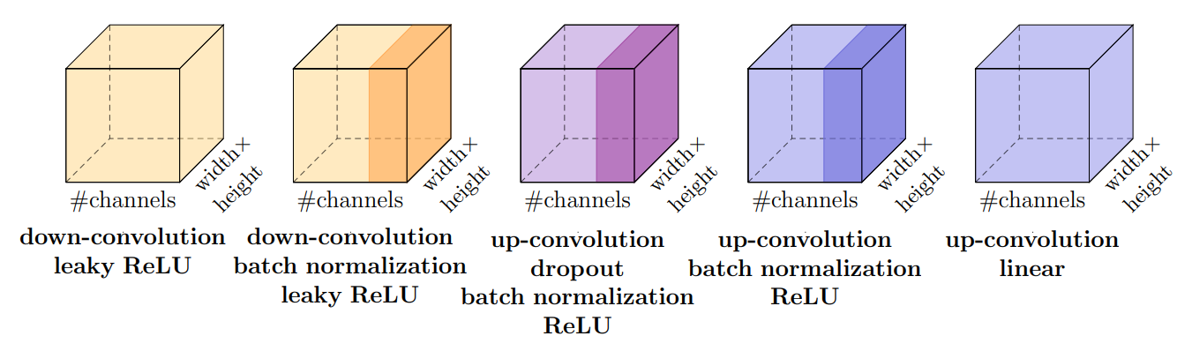
Generator Architecture

Slide 20
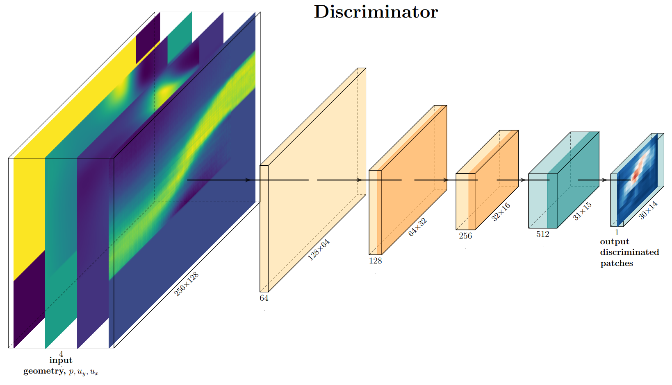
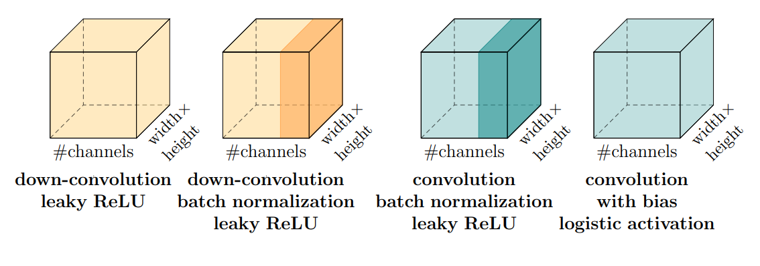
Discriminator Architecture

Slide 21
5. Initial Results

Slide 22
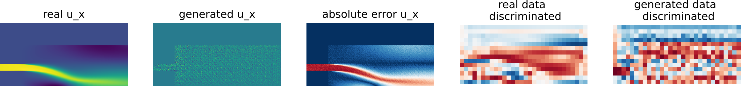
Training Progression
steps
1000
2000
3000
6000
12000
24000

Slide 23
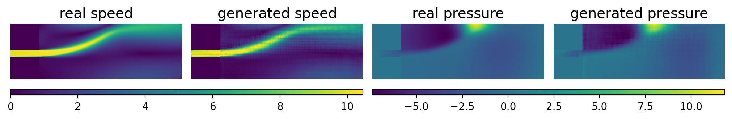
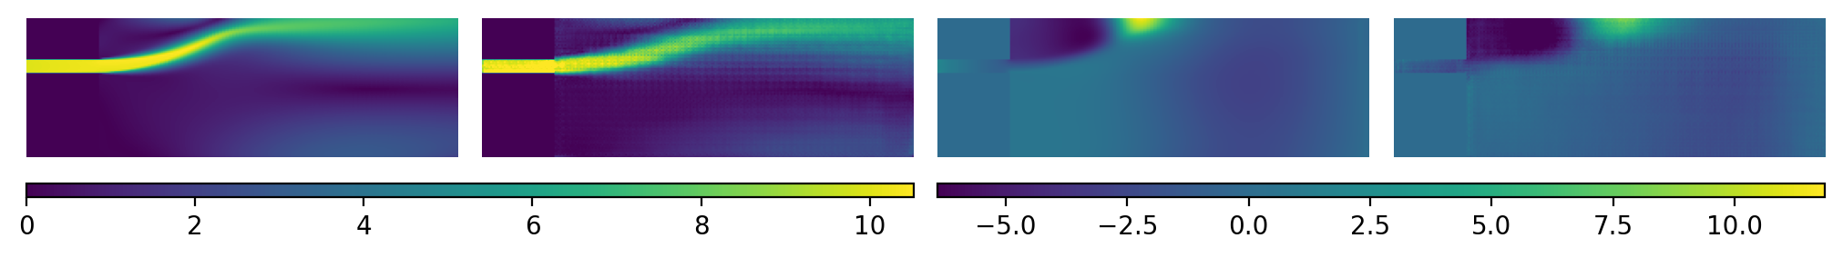
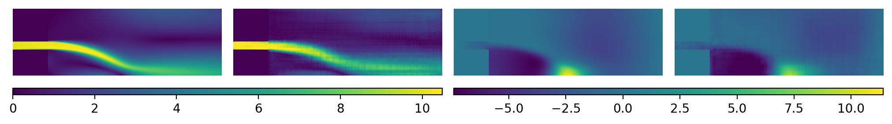
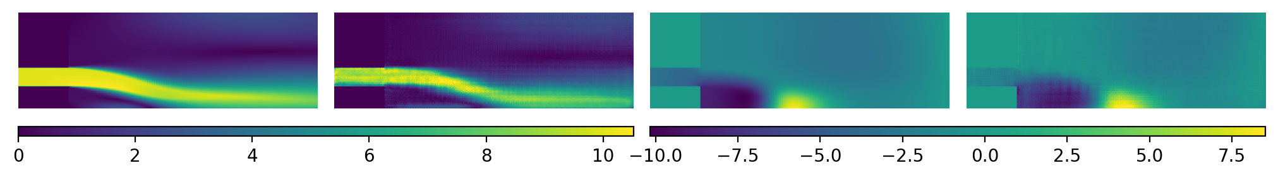
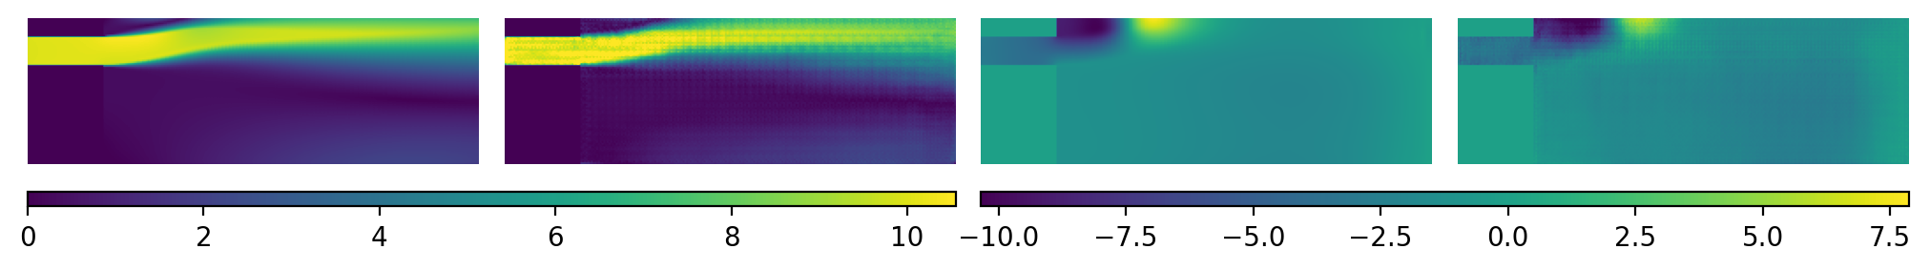
Sample Results

Slide 24
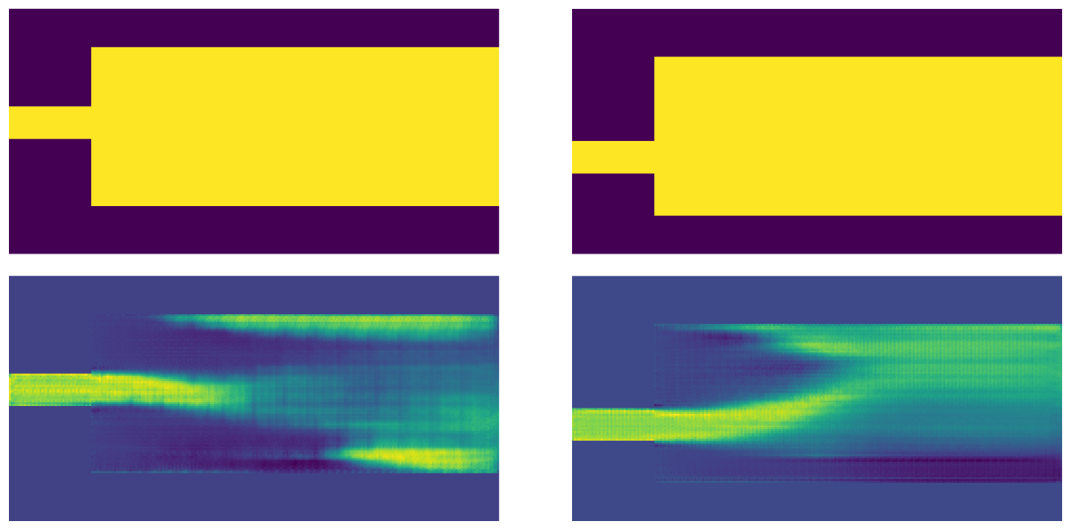
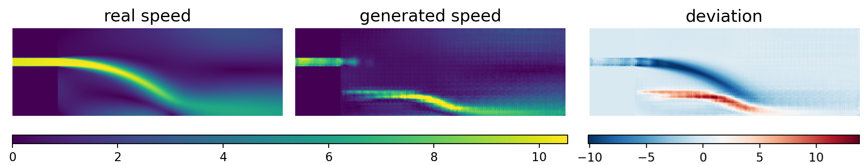
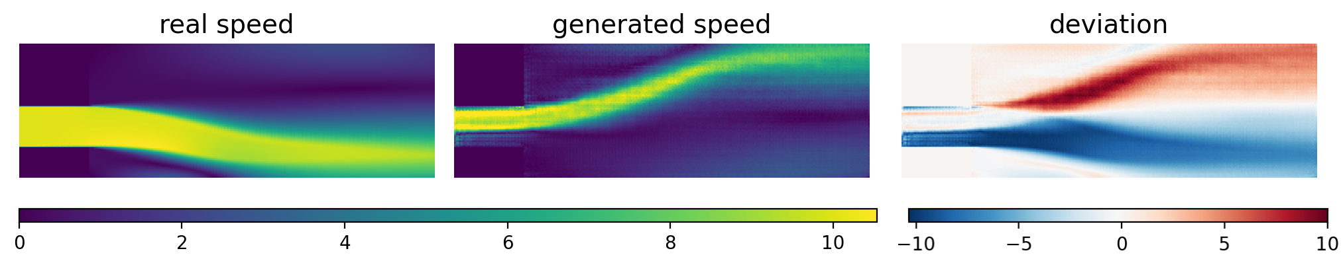
Failure Modes
Mode collapse: generator ignores inlet width and bifurcation
Discontinuous flow
Failure to generalize against translation of domain

Slide 25
6. Outlook & Scope

Slide 26
Outlook & Scope
Understand strengths & weaknesses of GAN approach for reduced order fluid models
Improve generalization, e.g. using data augmentation and larger more general datasets
Incorporate boundary conditions
Investigate to what degree the generator learns physical representations
Investigate imparting physical knowledge
Study improvements on GAN method
Analyze performance and contrast with comparable simulation

Slide 27
Thank you for your attention!
Any Questions?

